Slide 1
Global Superstore Sales Analysis
BY ASWATHY.S.S

Slide 2
Business objective
The company owns stores in multiple countries
The CEO wants to track the growth of sales over time.
This dashboard uses data from 2011 to 2014 to monitor revenue sources and other key performance indicators across different dimensions such as region, category, and customer segment. It helps support better business decisions with clear, data-driven insights.

Slide 3
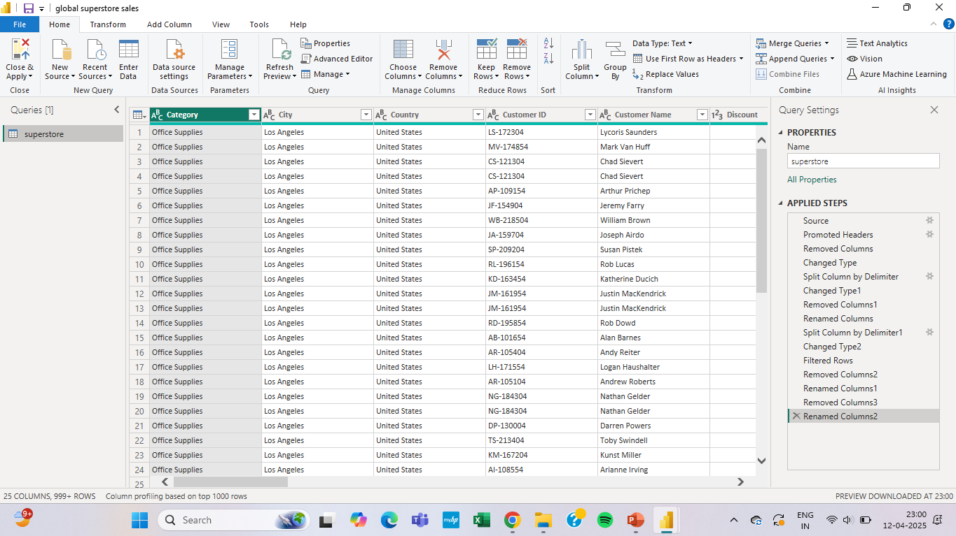
Data cleaning and preprocessing

Slide 4
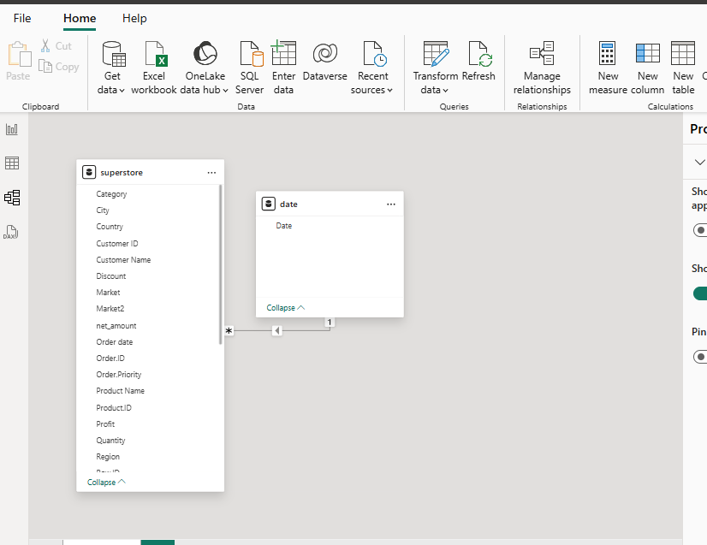
Data modelling

Slide 5
Dashboard summary
Created four KPI cards showing:
Total Revenue
Total Profit
Monthly Sales Growth (compared to previous month)
Developed two additional KPIs:
Revenue vs. Target Revenue
Profit vs. Target Profit
These KPIs help monitor overall performance and track progress toward business goals.
Line Chart created to show the monthly sales trend over time.
Filled Map used to visualize sales distribution across countries.
Table included to display cumulative (YTD) sales for a quick overall summary

Slide 6
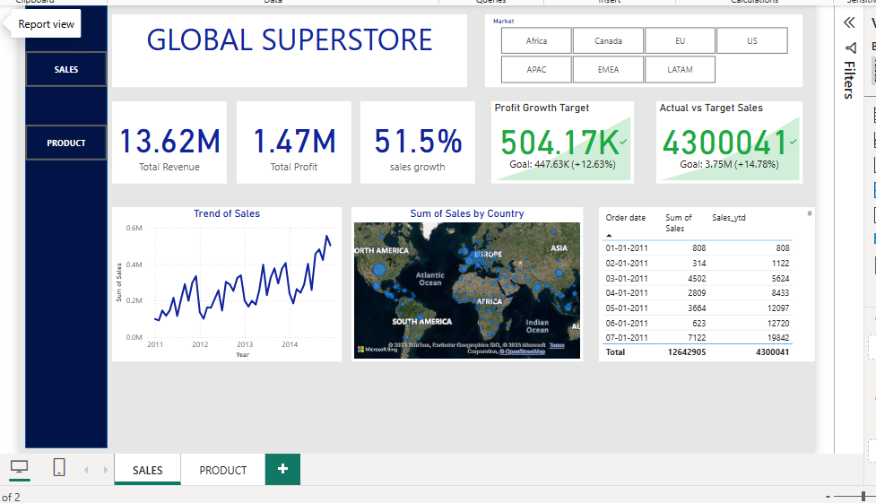

Slide 7
Donut Chart shows Product Count by Shipping Mode.
Bar Chart displays Top 10 Products by Sales.
Multi-row Card presents Total Sales by Product Category.
Treemap visualizes Sales by Sub-Category.
Funnel Chart shows the Number of Products per Customer Segment.
Comparison Tables highlight:
Current Sales
Previous Period Sales
Sales Growth %
Page Navigation Buttons added for smooth switching between report pages.

Slide 8
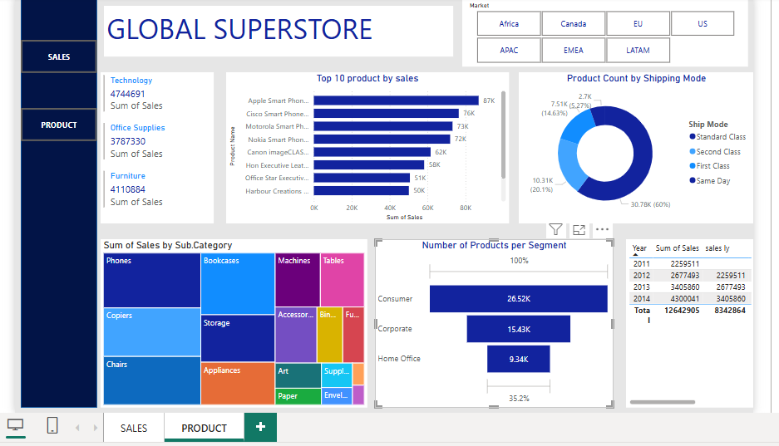

Slide 9
Insights
Region: North America has the highest sales.
Top Selling Product: Apple's full-size smartphone is the top-selling product.
Category: Technology has the highest sales among other categories.
Time Period: November 2014 has the highest sales.
Product Shipment: Most products shipped are based on the standard class.
Segment: The number of products per segment is classified under Consumer

